Slide 1
CSE 2102: Introduction to Software Engineering
Software Engineering Principles
Modularity, Incrementality, Generality, Anticipation,Abstraction

Slide 2
Modularity: Motivation
Problem statement:
Write a program to compute the square root of a given number. The
program accepts positive and negative numbers as well as zero as
input. The program accepts input from an ASCII file. If the input is a
positive number, then the output should be both positive and negative
square roots of the number. If the input is zero, then the output should
be zero. The output should be written to a file.
Should the code for input and output be embedded with the code
that computes square root, or should the code be in separate modules?

Slide 3
Modularity
Compose and design systems as set of modules
Two-phase application of separation of concerns
  Phase I: Module level
    Define details of individual modules
    What well-defined tasks does a module perform?
  Phase II: System level
    Characterize interactions among all modules
    What does a module need from other modules?
Methodological approaches:
  Top-down: Phase II followed by Phase I
  Bottom-up: Phase I followed by Phase II
Modularity inherent in engineering disciplines
Modularity transcends computing areas

Slide 4
Modularity (contd..)
Four benefits of modularity
  Decomposability: Problem to subproblems
  Composability: Combine subproblems to solution
  Understanding: Capability of understanding a system by understanding its pieces
  Modifiability: Capability of modifying a system by modifying its pieces.
Key supporting concepts: Cohesion and coupling

Slide 5
Concepts Supporting Modularity
Cohesion -- degree to which parts of a module are related.
Coupling -- indicates the interactions of a module other modules.
  Module should have as few interactions with other modules.
  If the number of interactions is high, then while understanding a module we may have to understand all those other modules with whom there is an interaction.
  Also, a change made to a module may impact many other modules.

Slide 6
Concepts Supporting Modularity
Referring to the square root example:
  Module implementing square root, should not include code to read and write from a file.
A good example of a system with high cohesion and low coupling is the electrical system in the house.
  Each appliance is a single cohesive structure, while these appliances are interconnected by simple wires which exhibit low coupling.

Slide 7
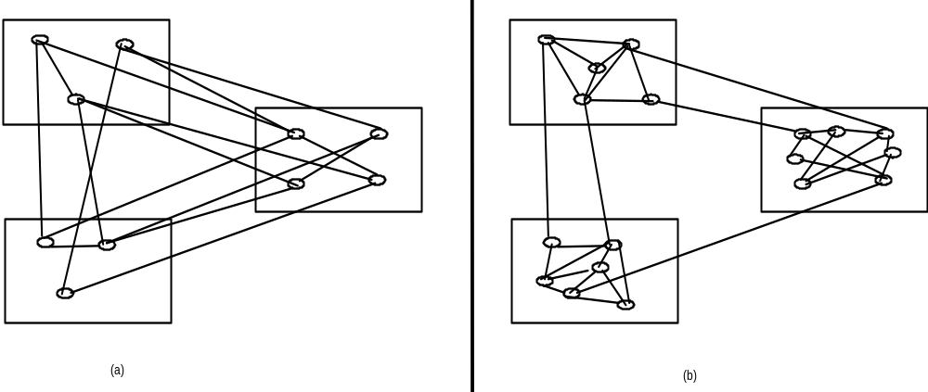
Modularity (contd..)
A visual representation of cohesion & coupling
A
A
B
B
C
C
Low cohesion, high coupling
High cohesion, low coupling
high coupling
low coupling

Slide 8
Modularity (contd..)
Modularity supported in programming languages
  “.h/.c” pairs
  Subdirectories at OS level or complier makes
  Ad-hoc modularity
C++
  “.h/.c” pairs for classes
  Adds abstraction, public interface, private implementation.
  Subdirectories at OS level or compiler makes
Ada95/Java
  Adds the package concept
  Rules for interactions/visibility within/among packages

Slide 9
Abstraction: Motivation
For a module, which uses the square root program, the only relevant
information is the input it accepts and the output it provides.
It need not be concerned with how the square root computation is
implemented.
Thus, the user of the square root program is only concerned with its
input/output behavior and may ignore the details of the implementation.

Slide 10
Abstraction
Identify the important aspects of a phenomenon and ignore its details
Special case of separation of concerns
Widely utilized to reduce complexity
People think and learn in abstractions
Goals of advances in design and programming
  Provide robust sets of abstractions
  Allow modeling to occur close to real world
The type of abstraction to apply depends on purpose
  Example : the user interface of a watch (its buttons) abstracts from the watch's internals for the purpose of setting time; other abstractions needed to support repair

Slide 11
Abstraction (contd..)
Abstraction yields models
  For example, when requirements are analyzed we produce a model of the proposed application.
  The model can be a formal or semiformal description
  It is then possible to reason about the system by reasoning about the model.
Consider the example of a wrist watch.
  User interface -- allows the user to adjust the time. UI abstracts the internals of the watch.
  Repair person -- abstraction may reveal the internal design of the watch so that he could repair it.

Slide 12
Example
Programming language semantics described through an abstract machine that ignores details of the real machines used for implementation
  Abstraction ignores details such as precision of number representation or addressing mechanisms
Abstractions in process
  When we do cost estimation we only take some key factors into account
  We apply similarity with previous systems, ignoring detail differences

Slide 13
Anticipation of Change: Motivation
Problem Statement:
Consider the square root program. In addition to accepting input and
writing output to a file, the program should also accept input from a
terminal and provide output to a terminal.
File i/p
Square root
File o/p
Terminal i/p
Terminal o/p
What if a combination of file and terminal I/p and o/p is desired?

Slide 14
Anticipation of Change: Motivation
Another example:
Initially, the user wants an error message if the input is negative.
Later, he changes his mind, and wants the complex root as output.

Slide 15
Anticipation of Change
Software changes and evolves throughout all stages from specification onward.
Difficult to predict every change, but the key is to anticipate future changes, and plan for them:
  Isolate pieces that are most likely to change in the specific portions of the product.
  Ideally, we should be able to make a change without causing much (any) ripple impact to any other portion of the product.
Is anticipation of change unique to computing?
Can future products be predicted?
Is planning cycle 5 or more years?

Slide 16
Generality: Motivation
Square root routine is being written for use in an application where its
input will never be negative.
- A quick solution will be write a program that does not handle
negative numbers at all.
Later, a new application needs square root computation. But this,
time, the output should be a complex root, if input is negative.
- If the original program considered the case of general numbers,
it could be reused in the new application.

Slide 17
Generality
While solving a problem, try to discover if it is an instance of a more general problem whose solution can be reused in other cases – anticipating what future products an organization may build.
  Supermarket system vs. Inventory control
  Hospital application vs. health care product
Investigate whether a general, off the shelf solution can be adapted to a specific problem:
  Inventory control for supermarket, auto parts, video tape rental, etc.
  Health care product for hospital, MD office, dental office, etc.

Slide 18
Tradeoffs in Generality
Carefully balance generality against performance and cost:
  Developing a solution for a general problem, may incur some additional short-term cost.
  Time and money could be saved by developing a solution for a special case,
  If the general solution is carefully designed, then it could be reused in many applications where it may save development costs and time, and this could more than offset the initial overhead.
Rarely, a general problem is easier to solve than a special case.

Slide 19
Generality & Reuse
Generality can promote reuse, which can save development cost and time, consider the composition of a software application.
65% of the code solves the general problems in the domain:
  If off-the-shelf solutions are available for these general problems, then we could adapt these solutions for our purpose, rather than developing them from scratch.
20% of the code is general or domain-independent:
  Memory management routines, mathematical libraries, etc, and could be reused.
Only 15% of the code is specific to the application that is being developed.
  Potentially, we should be able to reuse approximately 85% of the code with minor or no adaptations.

Slide 20
Incrementality: Motivation
To provide a quick solution, we may first write a program that accepts
positive numbers as input, and provides positive square root as output.
Later, we can add the capability to accept negative numbers as input.
Depending on the experience of the user in using the original program,
upon receiving a negative input, he may choose to:
- Print an error message
- Produce complex root

Slide 21
Incrementality
Accepted practice across disciplines
  Construction of houses and major projects
  Win 3.1, Win 95, Win 98, etc.
An engineering approach to problem solving
Difficult to anticipate what to build
  Would you have guessed the role of social media 5 years ago?
  Can’t be ignored for “future products”
  Future tools browser look-and-feel
Accepted practice in computing
  Alpha and Beta versions
  Adding features and tuning for performance

Slide 22
Incrementality (contd..)
Products are built in increments
  Quicker to market
  Focused, less errors in smaller increments
  Phased prototypes with increasing functions
Difficulty in constructing solutions to complex computing problems
  Utilize rapid prototyping to discern requirements from users
  Allow designers/developers to learn domain
  Add classes for successive prototypes
  Include new functionality in existing classes

Slide 23
SE vs. Traditional Engineering
Three principles that highlight the differences between software engineering and other disciplines:
  Anticipation of change, incrementality, and generality.
Due to the malleable nature of software:
  Quite natural to build a software product in increments and deliver subsets, however, we would never imagine delivering an elevator without doors, and then delivering cars and other accessories later on.

